Slide 1
Flatter fitness landscapes in CIN lines can help explain taxol resistance

Slide 2
CIN is an evolutionary process
Tumor cells displaying CIN (chromosome instability) develop aneuploidy over time
Different karyotypes have cell-specific relative fitnesses
  Can we exploit evolution of particular aneuploidy phenotype therapeutically?
Difficult to track in vivo -> need for modeling

Slide 3
Evolutionary biology can provide explanations for:
How does the population karyotype evolve after an initial missegregation event?
How does aneuploidy “act oncogenically or as a tumor suppressor”?
Can altering CIN rates make cancers more susceptible to treatment?
Notes:
Don cleveland paper

Slide 4
Understanding differential CIN response in vitro and in silico
Understanding differences in CIN versus non-CIN cell lines
Can increasing missegregation rate be harmful to CIN cells?
How does CIN contribute to tumor heterogeneity and patient prognosis?

Slide 5
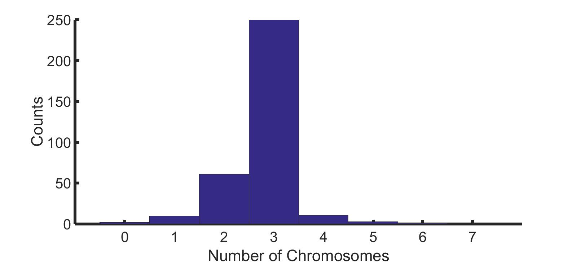
Track CIN and non-CIN chromosome distributions over time
What can we learn from these distributions?
Notes:
Hist example

Slide 6
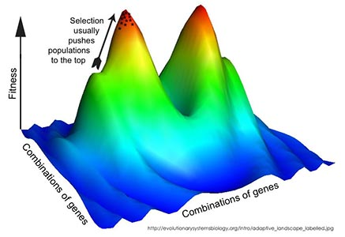
Ploidy can contribute selective (dis)advantage
Fitness landscape: mapping characteristics (e.g. karyotype data) to likelihood of reproduction
Will approximate discrete chromosome counts as continuous equation
http://evolutionarysystemsbiology.org/intro/adaptive_landscape_labeled.jpg

Slide 7

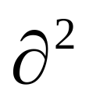
Modeling CIN as a diffusion-growth process
How population changes with time (generations)
Chromosome number after missegregation
Cell growth proportional to fitness
p(x,t)
p(x,t)
=
μ
+
F(x)
p(x,t)
t
x²
p(x,t): Population distribution at x = number of chromosomes and t = time
μ: chromosome missegregation rate
F(x): fitness of a cell with x number of chromosomes
Notes:
Make animated, color coded, arrows – show parts of the equation one at a time and explain what second derivative is

Slide 8
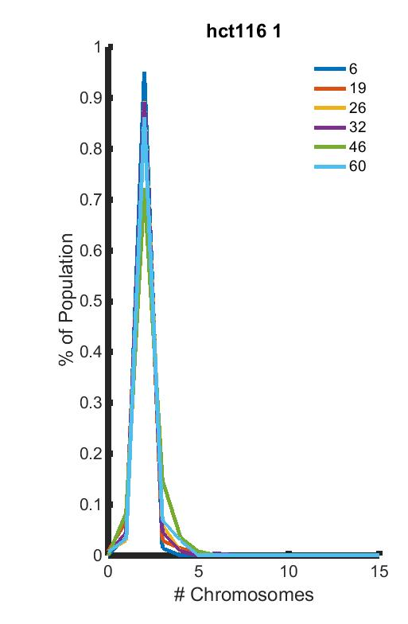
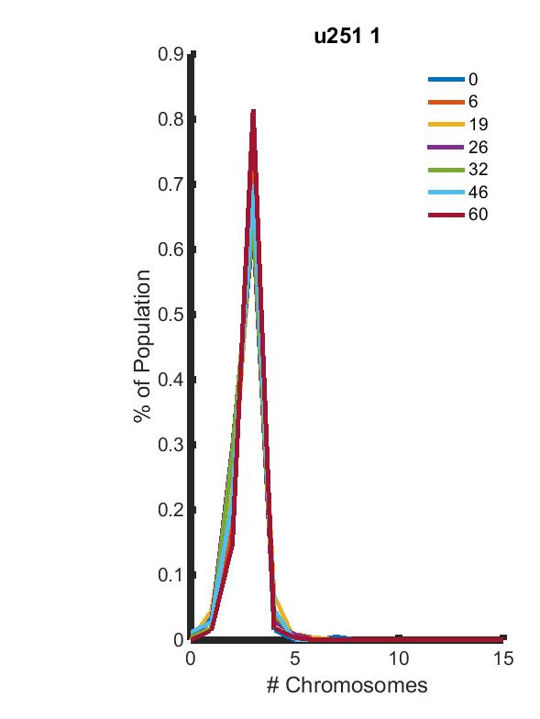
CIN chromosome distributions reach steady-state relatively quickly

Slide 9
Deriving fitness landscapes under steady-state assumption
Given the missegregation rate and steady-state population distribution, we can predict the underlying fitness landscape
p(x,t): Population distribution at x = number of chromosomes and t = time
p(x,t)
-
μ
x²
F(x): fitness of a cell with x number of chromosomes
=
F(x)
μ: chromosome missegregation rate
p(x,t)

Slide 10
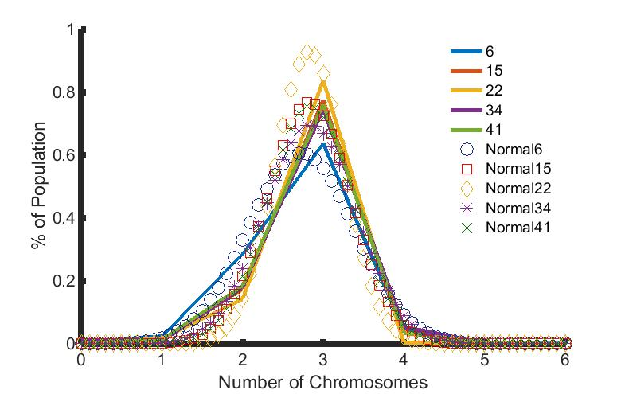
Predicting fitness landscapes from experimental data
Fit data to continuous distribution in Matlab
Two fits used: normal distribution and GEV (generalized extreme value) distribution

Slide 11
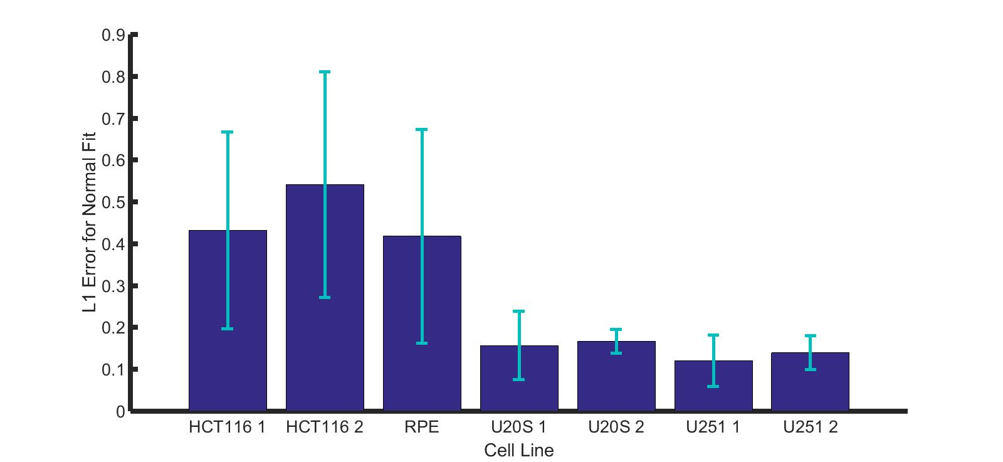


CIN lines better fit by normal distribution than non-CIN lines
Non-CIN
CIN

Slide 12
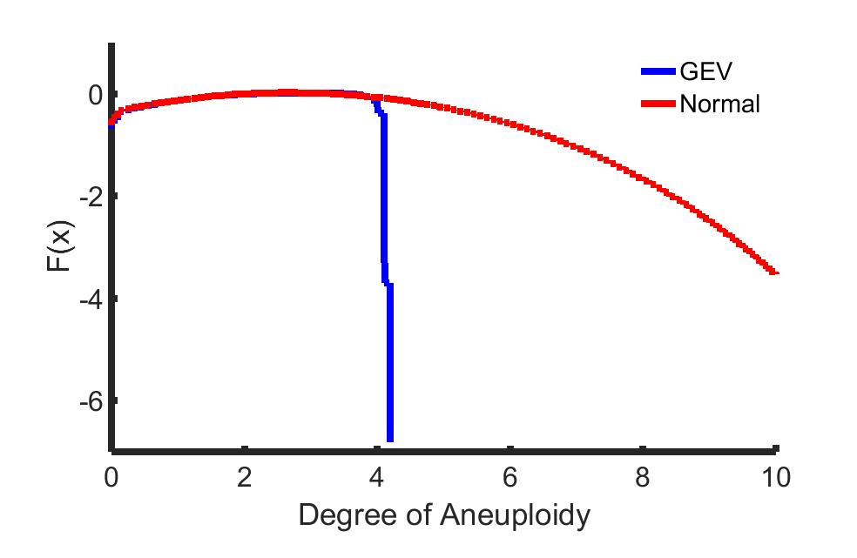

Normally fit distributions have flatter fitness landscapes
Fitness
Number of Chromosomes

Slide 13
Connection to therapeutic effectiveness?
CIN lines have flatter fitness landscapes than non-CIN
  No sharp drop-off in fitness
Mitotic-targeting treatments less effective on CIN lines than MIN?
  Taxanes, radiation?
Changing missegregation rate without changing fitness landscape may actually help population survive

Slide 14
Understanding differential CIN response in vitro and in silico
Understanding difference in fitness landscapes in CIN versus non-CIN cell lines
Can increasing missegregation rate be harmful to CIN cells?
How does CIN contribute to tumor heterogeneity and patient prognosis?

Slide 15
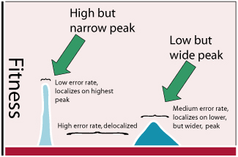
Can we use evolutionary theory’s error catastrophe phenomenon?
Razib Khan - http://scienceblogs.com/gnxp/2007/03/13/lowered-expectations-mutation/

Slide 16
Is missegregation rate a viable target for CIN cancers?
Have predicted fitness landscapes from earlier
How does changing missegregation rate with these landscapes affect population trends?
Solving equation for time/ploidy data
  Error catastrophe: expect missegregation rates > error threshold to lead to overall decreased fitness

Slide 17
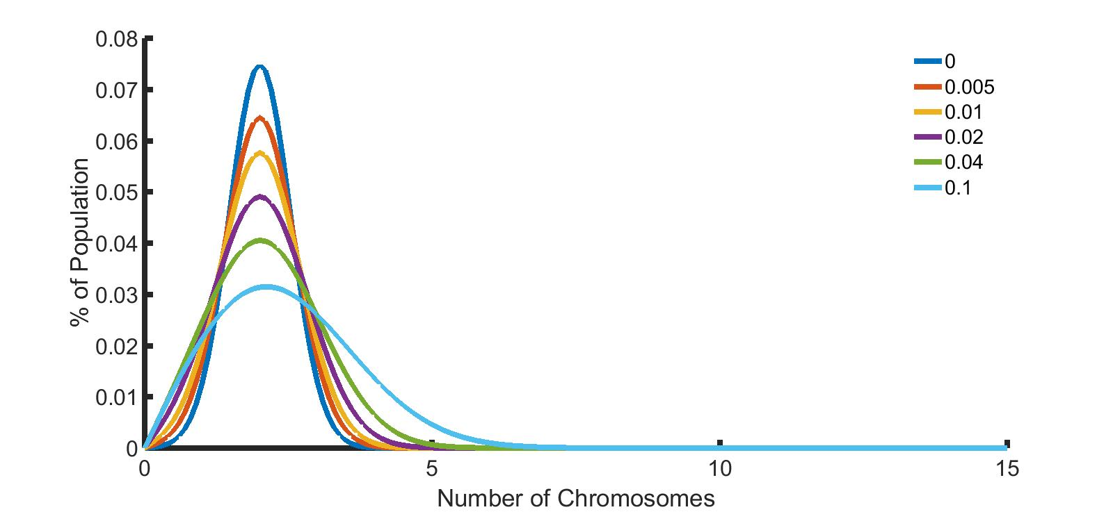
Increasing missegregation rate flattens chromosome distribution

Slide 18
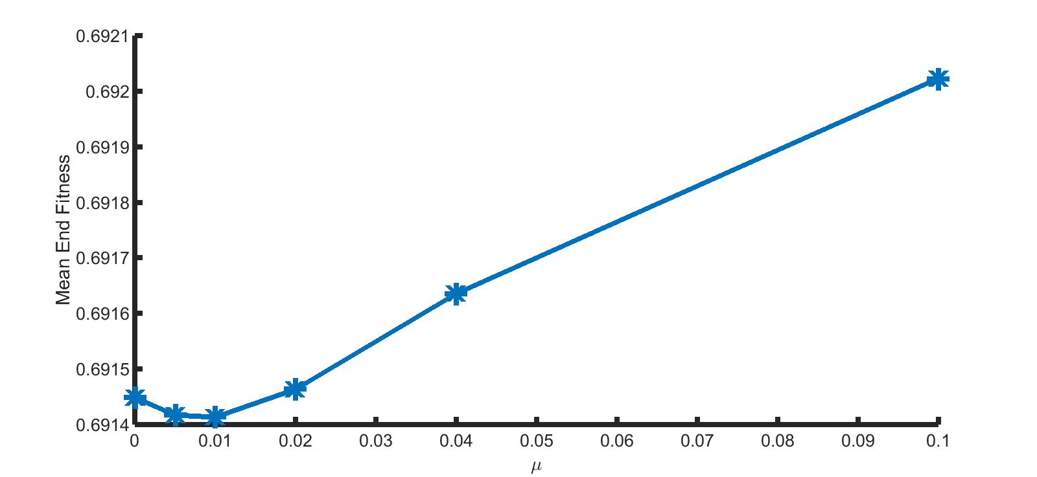
On physiological scales, increased μ → increased mean fitness
Mean End Fitness
Missegregation Rate

Slide 19
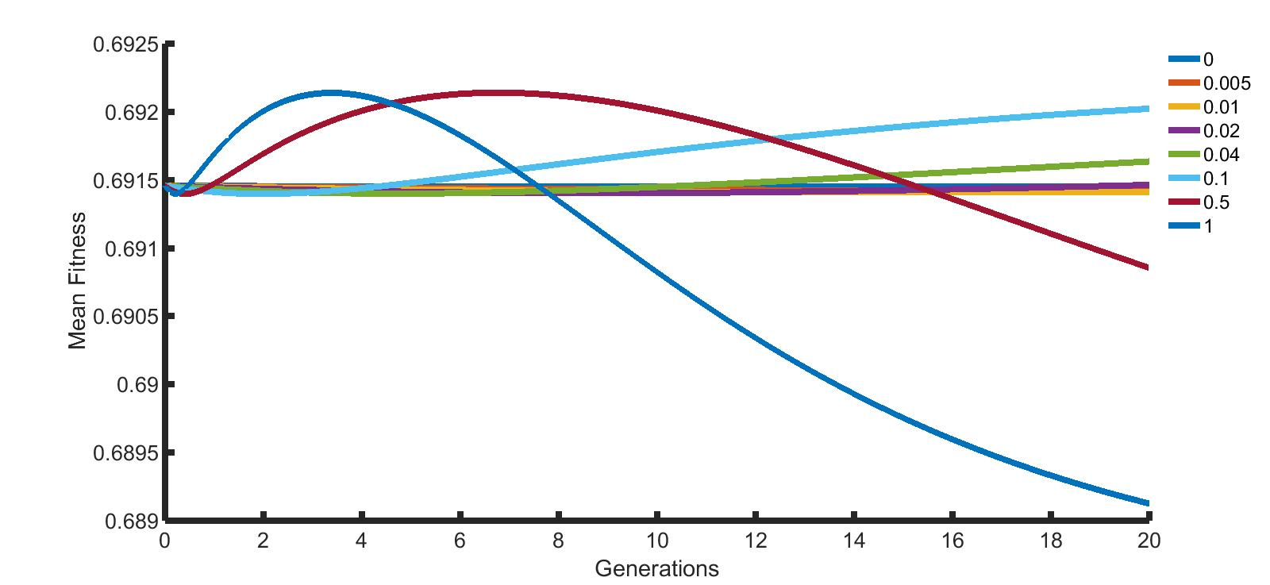
Very high missegregation rates necessary for therapeutic effect
Mean Fitness
Generations

Slide 20
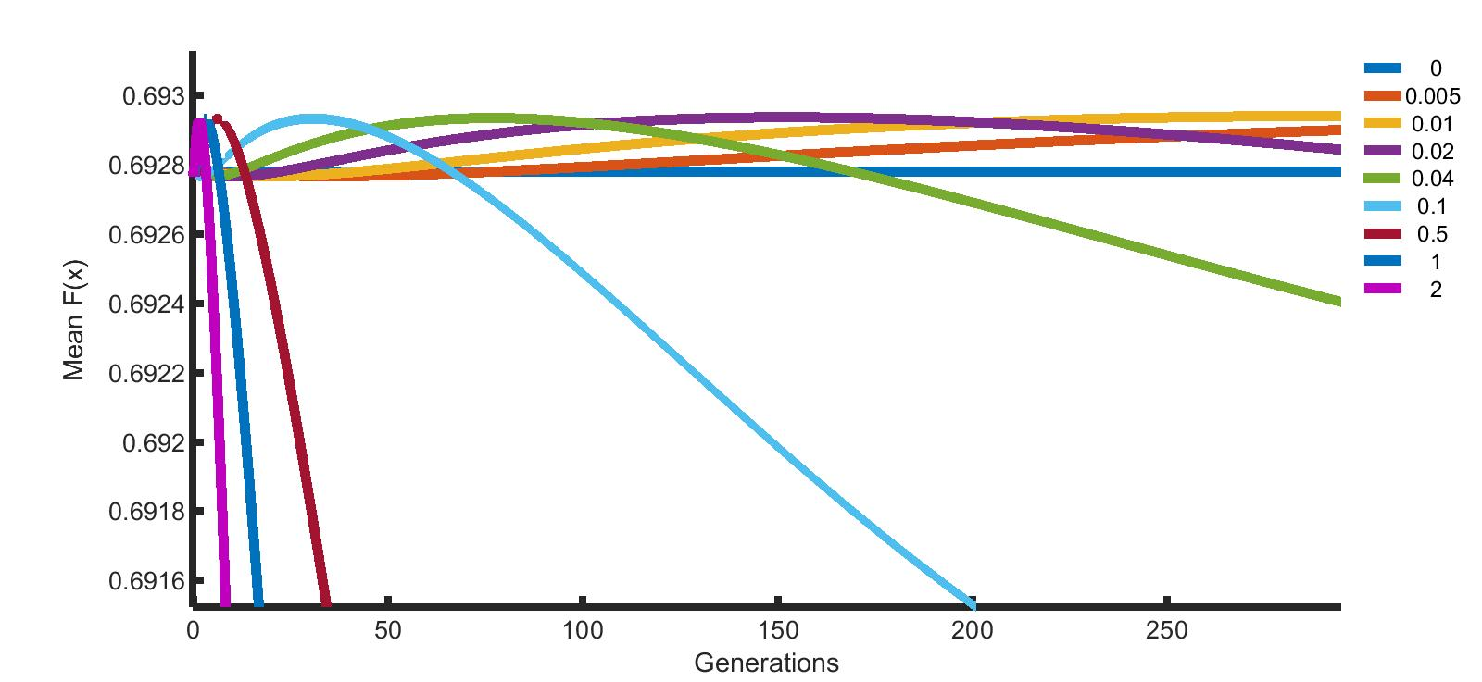
Similarly, effects better seen on very large timescales
Mean Fitness
Generations

Slide 21
Increasing missegregation can detract from CIN drug’s effectiveness
Most drugs have multiple effects on cells
  Including mitotic changes
Increasing missegregation for CIN cancers may lead to increased tumor fitness
  On physiological scales
  Detracts from drug’s efficacy

Slide 22
Understanding differential CIN response in vitro and in silico
Understanding difference in fitness landscapes in CIN versus non-CIN cell lines
Does error catastrophe exist in CIN and MIN lines?
How does CIN contribute to tumor heterogeneity and patient prognosis?

Slide 23
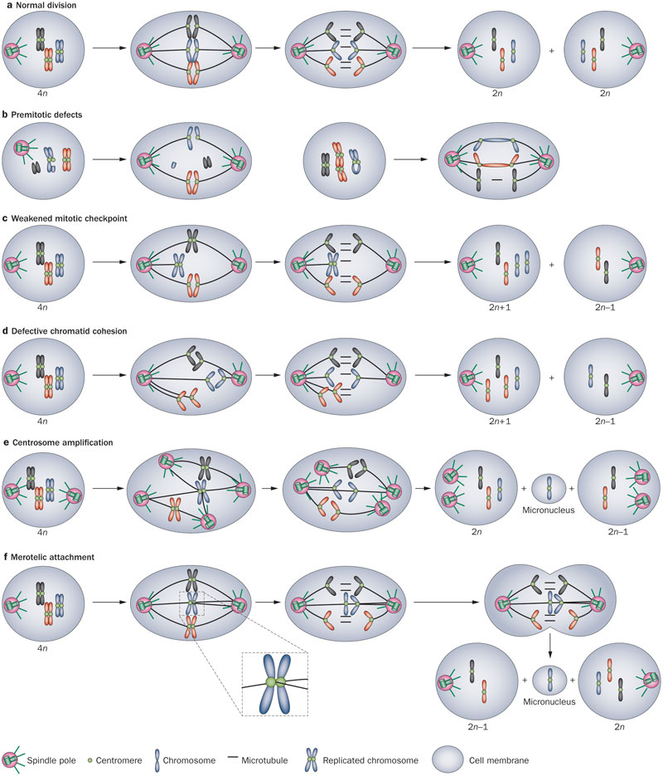
Tumor aneuploid heterogeneity caused by complex factors
Pre-mitotic effects
Weakened mitotic checkpoint
Defective chromatid cohesion
Centrosome amplification
Merotelic attachment
A'Hern, RP et al. Nature Reviews Clinical Oncology 10, 357-364 (June 2013)
Notes:
Picture of cin

Slide 24
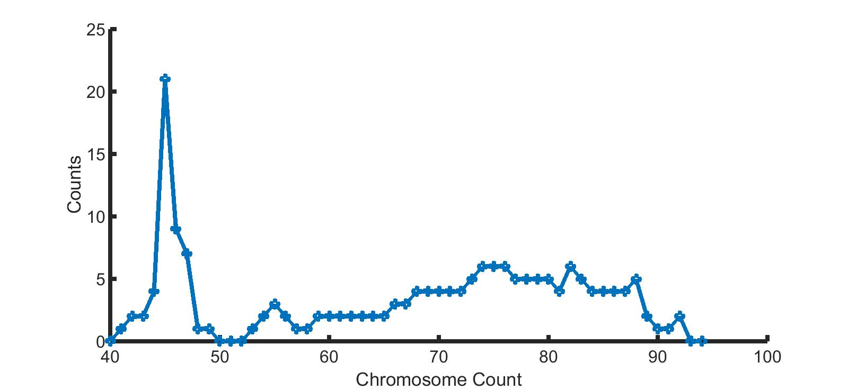
Glioblastoma NOS shows bimodal distribution

Slide 25
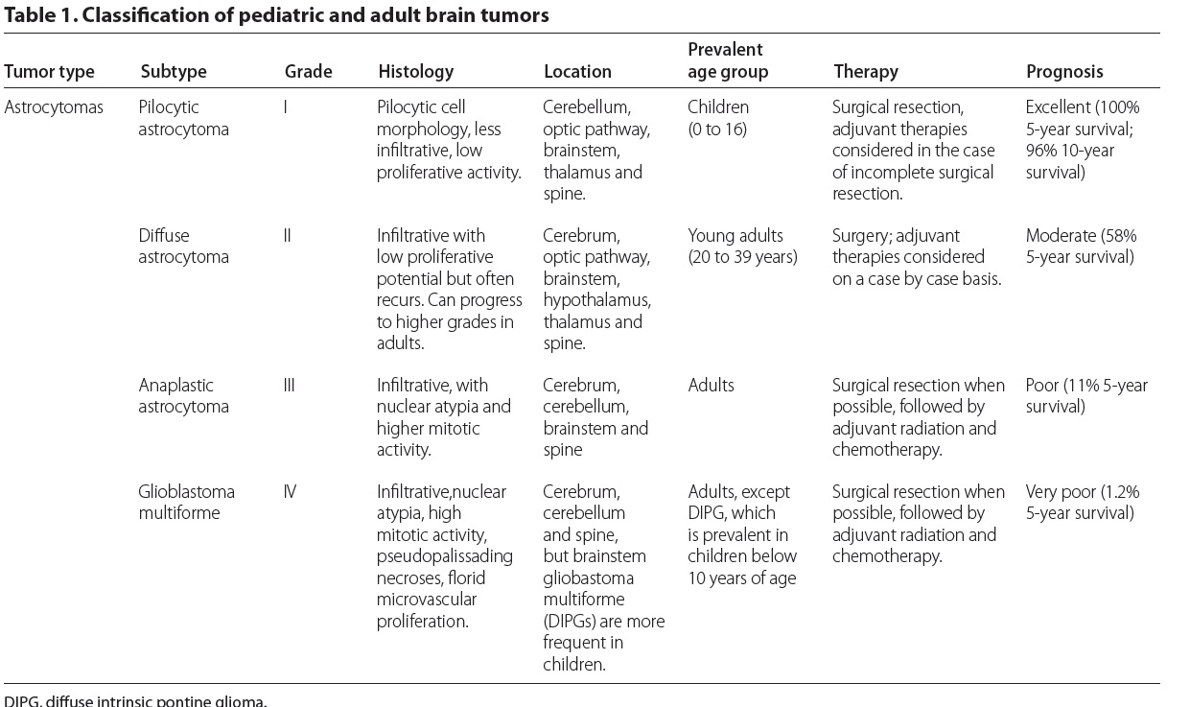
Astrocytomas have different prognoses based on grade
Gerges et al. Genome Medicine 2013, 5:66

Slide 26
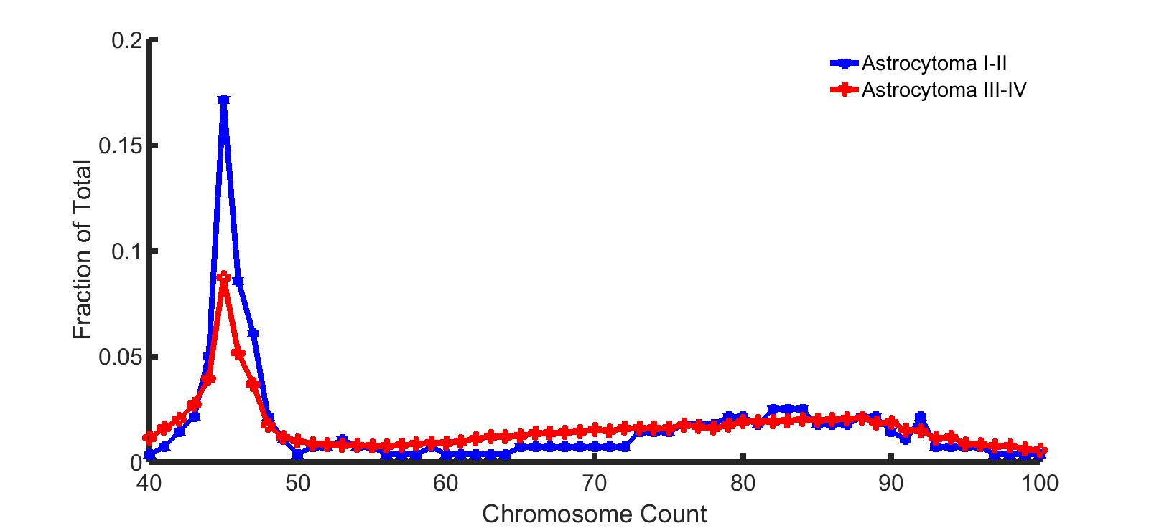
Astrocytomas have cross-patient bimodal distributions influenced by prognosis

Slide 27
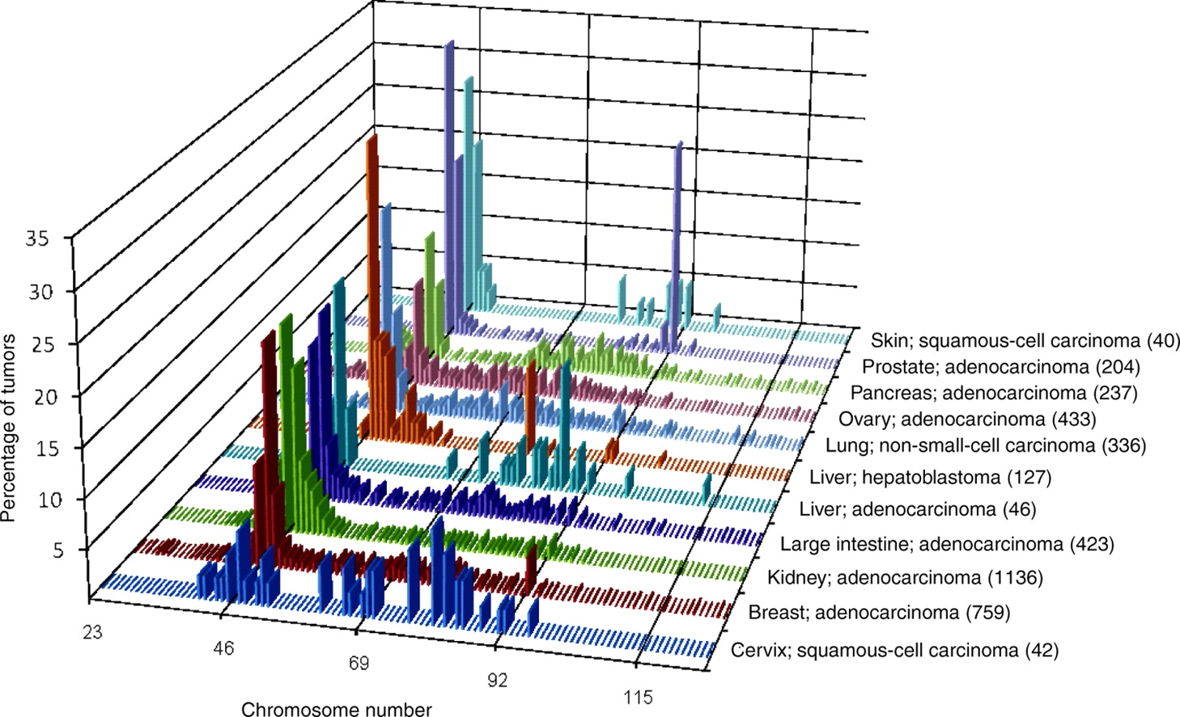
Trend toward bimodality common across different CIN tumors
Storchova and Kuffer, JCS 2008
http://jcs.biologists.org/content/121/23/3859
Notes:
“In fact, spontaneous unscheduled tetraploidization can be far more frequent than a gene mutation or chromosome-missegregation error.”

Slide 28
Extracting fitness landscapes from full chromosome distributions
Previous FISH data: Chr10
Now we have whole chromosome counts – how does this affect fitness for glioblastoma cells?
  Can we understand how underlying fitness contributes to CIN’s “debut”?
  Using modeling to understand what creates bimodal pattern

Slide 29
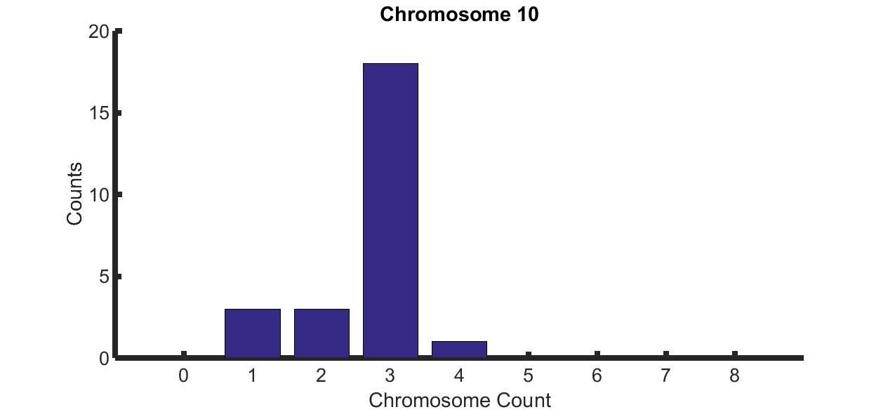
Individual variance could contribute to overall heterogeneity

Slide 30
Variance in individual chromosome counts doesn’t explain overall variance
Variance of the sum of total chromosome counts: 135.5000
Sum of the variances of each individual chromosome: 19.5033
Sum of variances != variance of sum: deeper correlations
Notes:
Add slide in before that shows sample variance

Slide 31
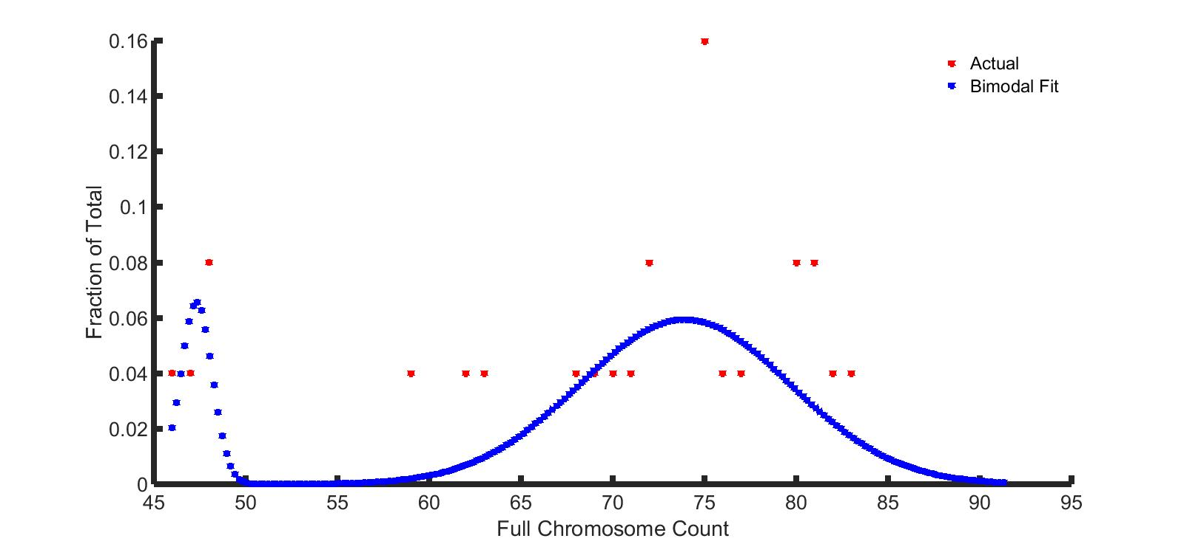
SKY data exhibits bimodality similar to cross-patient samples

Slide 32
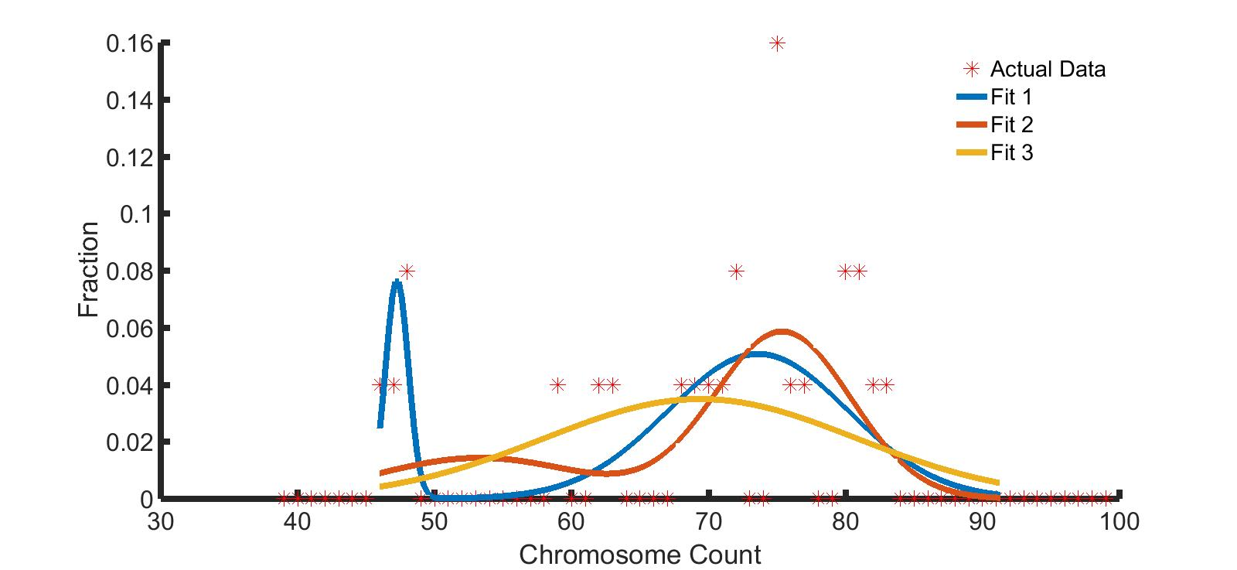
Trying different bimodal fits
99% give Fit 1 (least error) for 456 trials
  Other fits have difficulty w/ bimodality

Slide 33
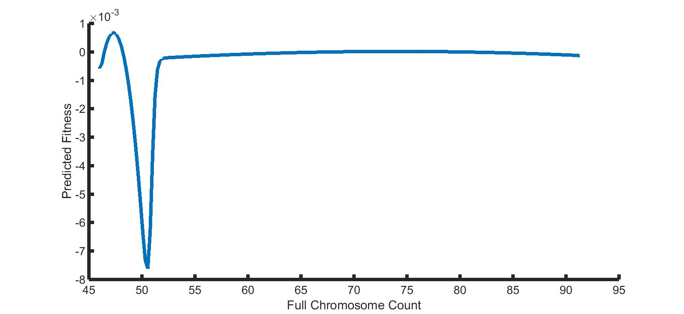
Predicted fitness landscape confirms necessity of tetraploid jump
Notes:
If you’re tetraploid first, you have way more genetic/karyotypic things to discover, as opposed to needing to adapt immediately and make the jump
Neg – pop growth

Slide 34
Previous model doesn’t account for direct jump to tetraploidy
How population changes with time (generations)
Chromosome number after missegregation
Cell growth proportional to fitness
p(x,t)
p(x,t)
=
μ
+
F(x)
p(x,t)
t
x²
p(x,t): Population distribution at x = number of chromosomes and t = time
μ: chromosome missegregation rate
F(x): fitness of a cell with x number of chromosomes
Notes:
Make animated, color coded, arrows – show parts of the equation one at a time and explain what second derivative is

Slide 35
Simulating tetraploidy jumps using Markov chain to explain bimodality
m1
m2
m3
. . .
2N-1
2N
2N+1
2N+2
4N
ki

Slide 36
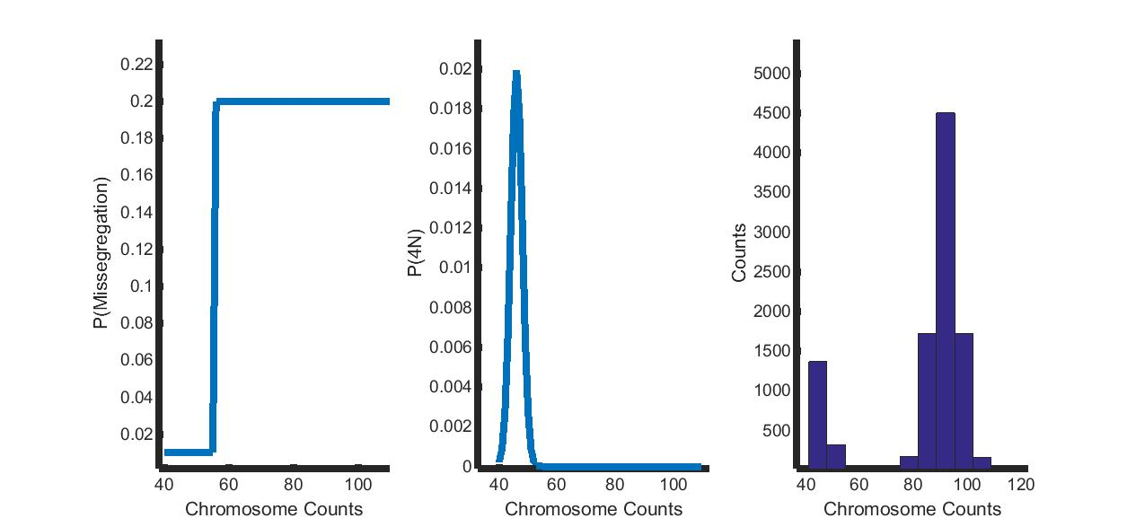
We can recreate bimodal distribution but not peak locations
Peak not close to 3N!
Notes:
Add arrow at location of peak, 100 generations

Slide 37
Transitioning to CIN
Previously, used state-machine model to account for tetraploidy jumps
Does changing the timescale allow us to see our peak shift to 3N?

Slide 38
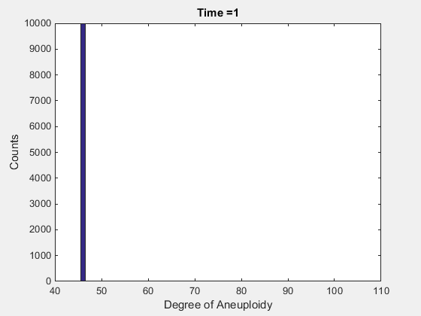
Can recreate bimodality but not necessarily location of peaks
Notes:
Transition rate jump to 0.2, for GIFs overlay what actual distribution is

Slide 39
Very high missegregation rates can mimic actual data at long timescales
Notes:
Transition rate 0.5

Slide 40
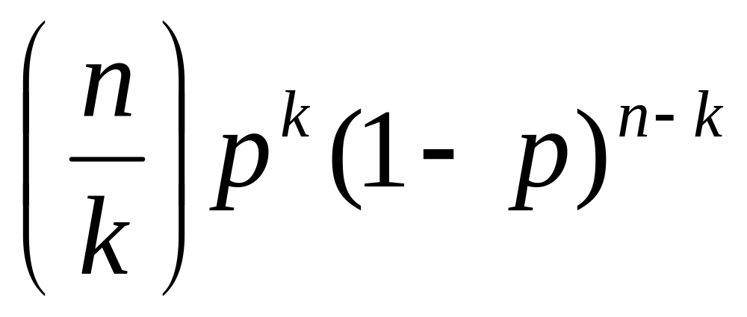
Incorporating ability to missegregate multiple chromosomes
Use binomial distribution to simulate ability to missegregate multiple chromosomes . . .
n = total number of chromosomes
k = number of chromosomes to missegregate
p = chance of missegregation

Slide 41
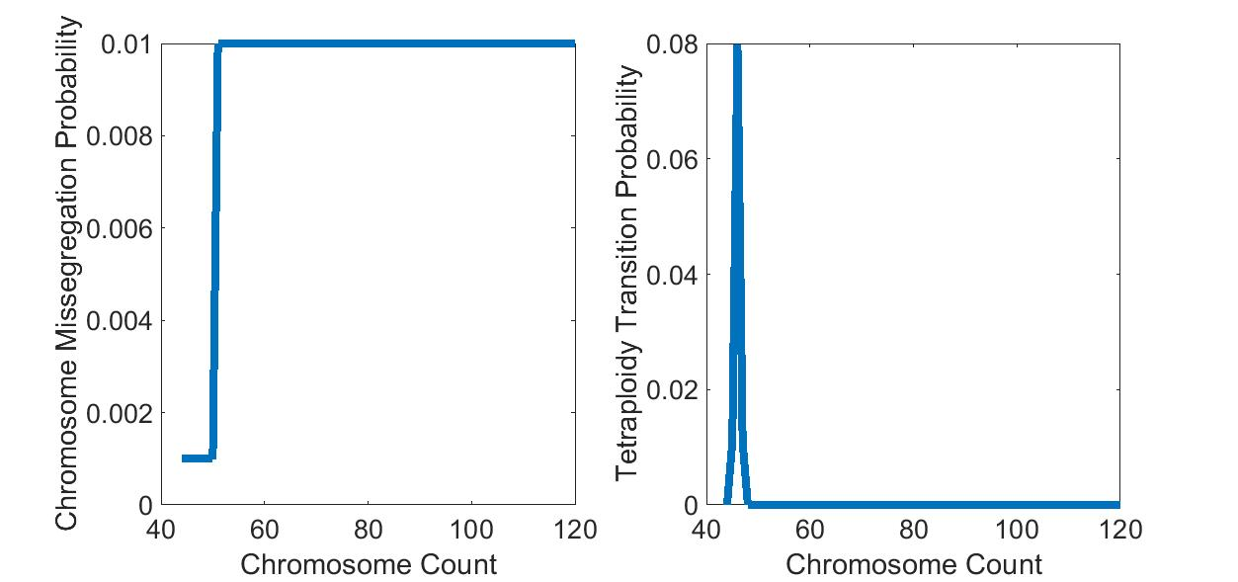
Parameters for binomial distribution fit

Slide 42
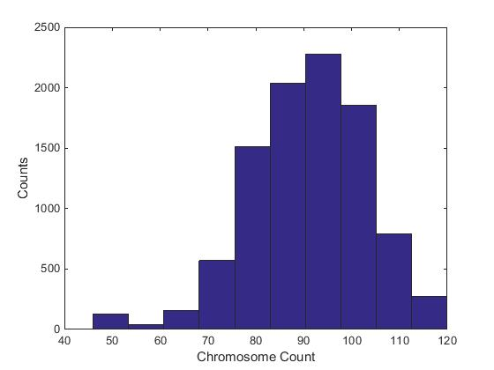
Multiple missegregation events at 500 generations

Slide 43
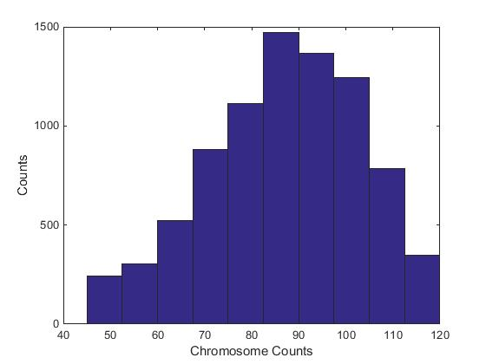
Multiple missegregation events at 1500 generations lose bimodality

Slide 44
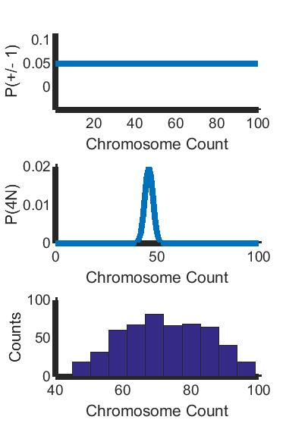
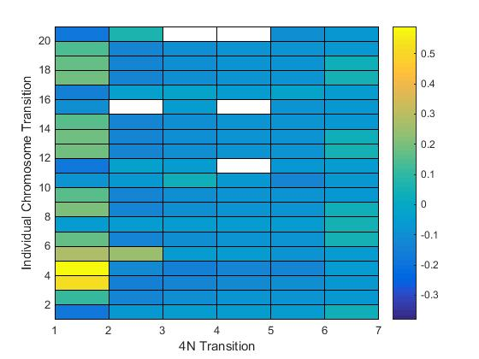
Parameter sweep yields correct peak but no bimodality
Notes:
Make plots on same slide

Slide 45
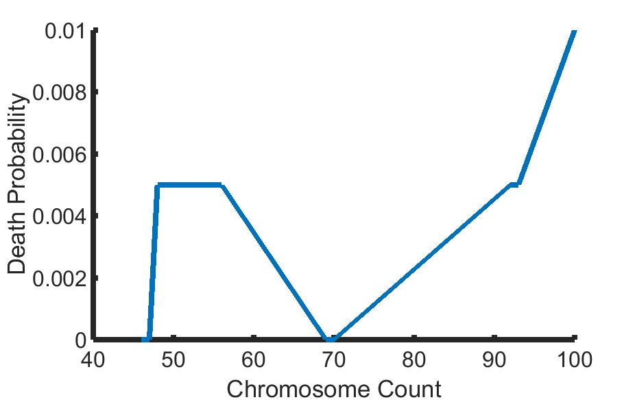
Using underlying fitness to try to explain data
Beyond tetraploidy less common
No cells with counts in range
Cell count peak around 3N
Notes:
Only show for 46-100, essentially inverse of the distribution/fitness landscape, have arrows pointing to different regions and explain them, need to be explicit with what the artificial generations mean – mention previous work

Slide 46
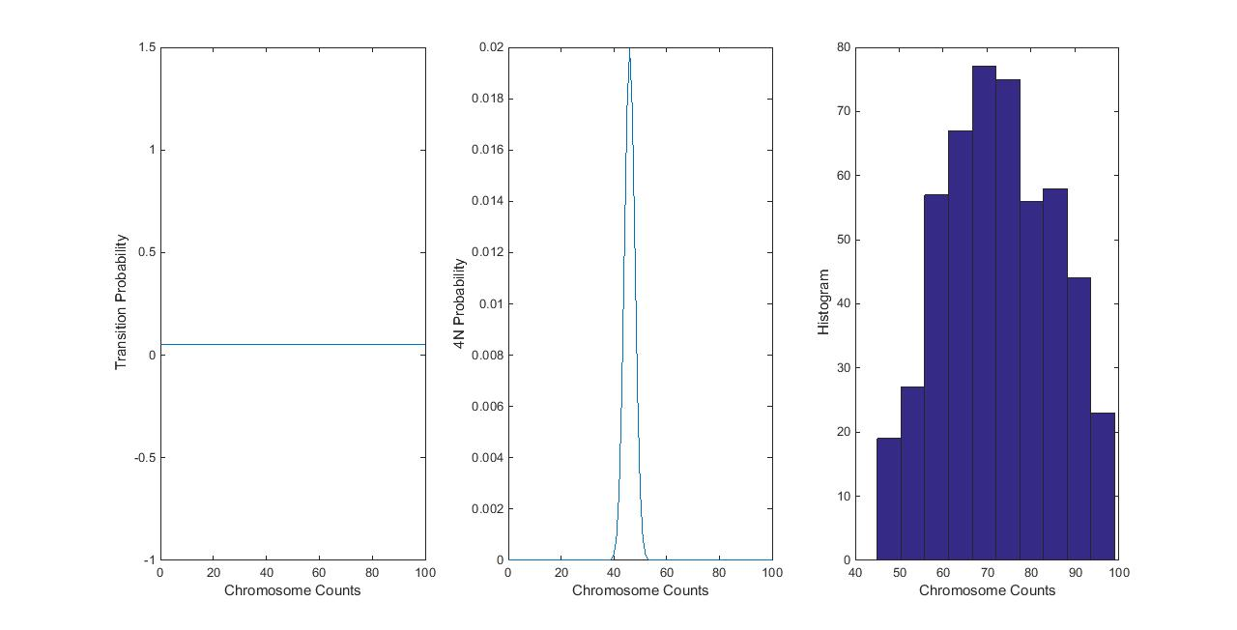
Fitness does not help recreate bimodality
0 0.1 0.2
0 40 80
Transition Probability
-0.5 0 0.5 1.5
4N Probability
Counts
20 60
20 60
20 60
Chromosome Counts
Chromosome Counts
Chromosome Counts

Slide 47
Conclusions
Simple models – missegregation, tetraploidy, and fitness - not enough to explain pattern of heterogeneity
Can get either ~3N peak or bimodality, but not both
Tumor aneuploidy distributions likely caused by deeper correlations that need to be tested
Notes:
Don’t say anything about drug stuff

Slide 48
Appendix

Slide 49
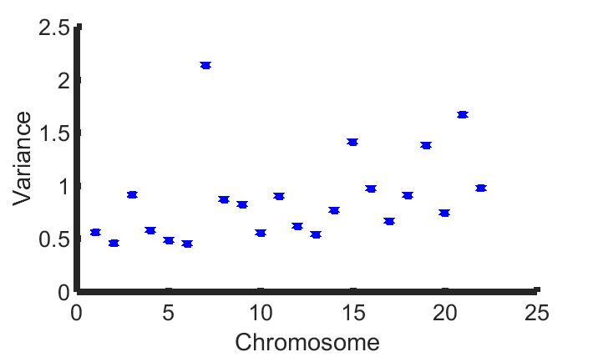
Variance of individual chromosomes
Notes:
Correlation: 0.3569, note weirdness of chromosome 7

